Slide 1



Slide 2
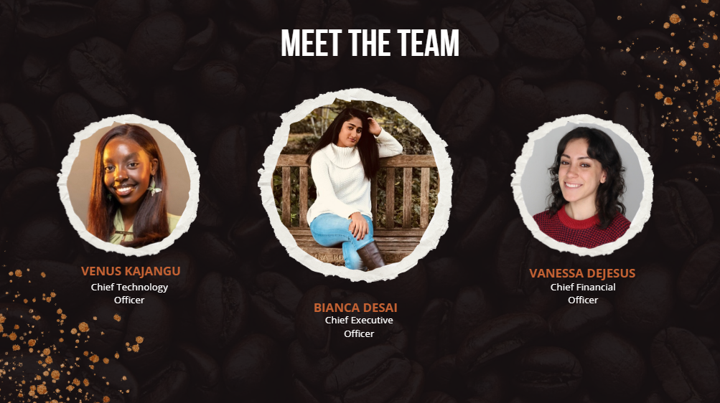

Slide 3
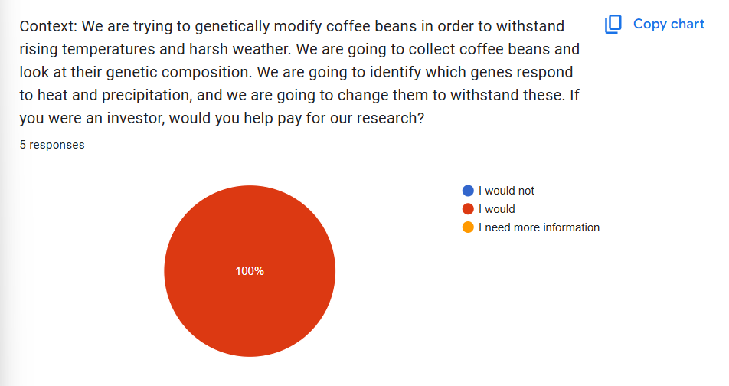

Slide 4
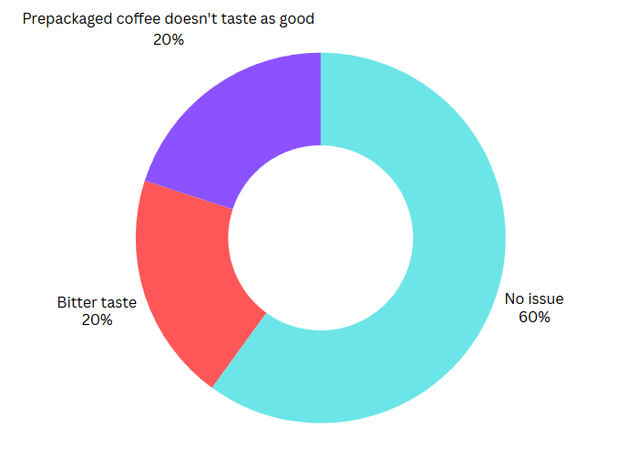
We asked people if they have ever had an issue with coffee beans before (ex. too expensive, bland taste)

